Slide 1
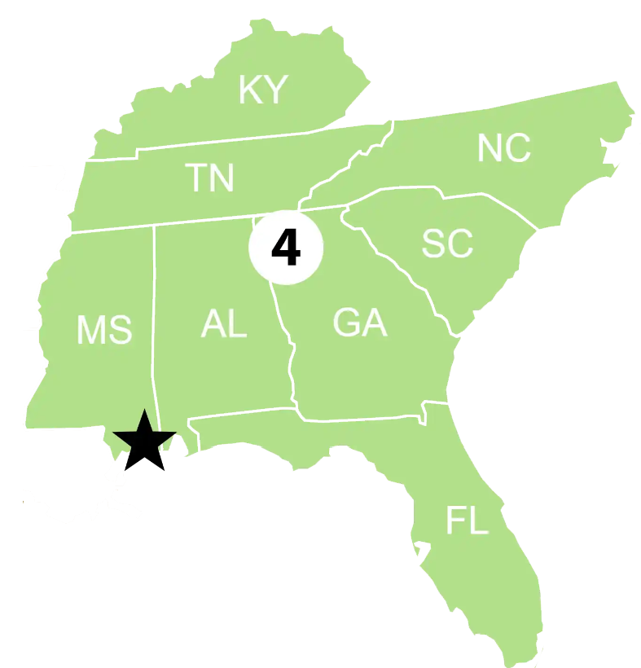
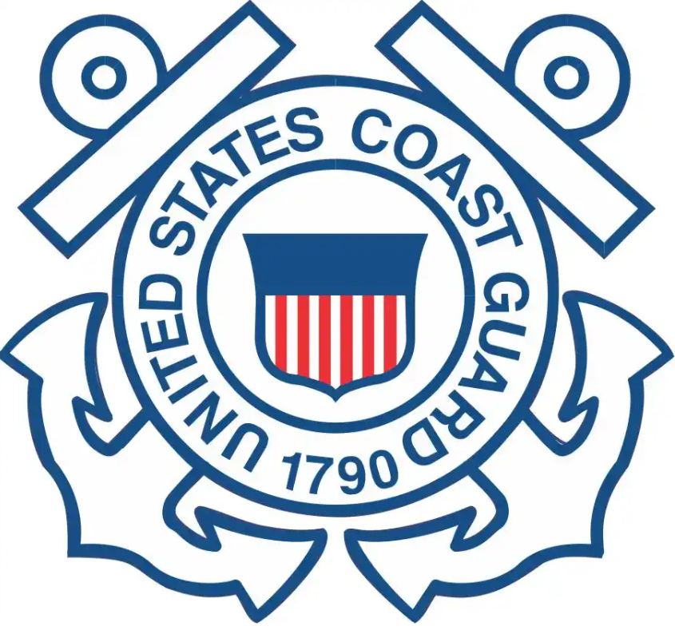
Sector Mobile
Federalized cases:
1. UCGPN24004 – SNORKLE DEEP, sunken rec vessel, English Channel, Pensacola, FL
2. UCGPN24008 – Mobile River Mystery Oil Bubbles, Mobile Ship Channel, Mobile, AL
3. UCGPC24009 – Mobile River Mystery Tank, Mobile River, Mobile, AL
4. UCGPN24022 – Bayou Chico Red Diesel Mystery Sheen, Bayou Chico, Pensacola, FL
5. UCGPN24025 – Sunken shrimp vessel, Biloxi Small Craft Harbor, Biloxi, MS
Notable cases or engagements:
Sector Mobile IMD responded to a mystery sheen in the Mobile River and engaged with NOAA SCC, EPA Region IV, ADEM, ACOE and D8 DRAT for concurrence on best course of action for a mystery oil seepage in the Mobile River from an unknown source. After extensive dive operations failed to identify the source, the recommended course of action was to utilize containment boom and observe for significant expression events over an extended time rather than utilize excavation tactics, saving costs to OSLTF and possibly preventing further disruptions in heavily industrialized area.
RRT-related concerns in your AOR:
1. Post Storm engagement with participating agencies to ensure respective priorities/best practices are identified and taken for consideration during response actions.
2. Need for continued active engagement in exercise with participating agencies.
3. Participation in State Hurricane Exercises, so MA discussion can take place prior to big events.

